Slide 1
Security Hardening – Case Study-SharePoint
Sharepoint 2013 STIG
DISA, Release 3
22 April, 2016
Sharepoint server side configurations

Slide 2
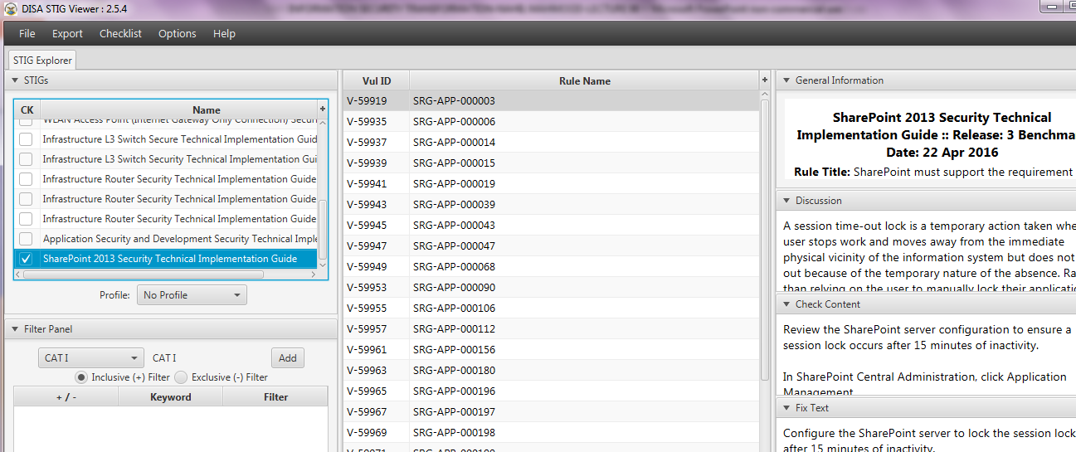
Security Hardening – Case Study-SharePoint
STIGVIEWER WINDOW

Slide 3
Security Hardening – Case Study-SharePoint
General Information:
Rule Title : For environments requiring an Internet-facing capability, the SharePoint application server upon which Central Administration is installed, must not be installed in the DMZ.

Slide 4
Security Hardening – Case Study-SharePoint
General Information:
Vuln ID: V-59995
STIG ID: SP13-00-000155
Severity: CAT II

Slide 5
Security Hardening – Case Study-SharePoint
Discussion:
Information flow control regulates where information is allowed to travel within an information system and between information systems (as opposed to who is allowed to access the information) and without explicit…

Slide 6
Security Hardening – Case Study-SharePoint
…Discussion:
…regard to subsequent accesses to the information.
SharePoint installed Central Administrator is a powerful management tool used to administer the farm. This server should be installed on a trusted network…

Slide 7
Security Hardening – Case Study-SharePoint
…Discussion:
…segment. This server should also be used to run services rather than user-oriented web applications.

Slide 8
Security Hardening – Case Study-SharePoint
Check Content:
For environments requiring an Internet-facing capability, ensure the SharePoint Central Administration application server is not in the DMZ.
Inspect the logical location of the server farm web front end…

Slide 9
Security Hardening – Case Study-SharePoint
Check Content:
…servers.
Verify the Central Administration site is not installed on a server located in a DMZ or other publicly accessible segment of the network.
If Central Administrator is…

Slide 10
Security Hardening – Case Study-SharePoint
Check Content:
installed on a publicly facing SharePoint server, this is a finding.

Slide 11
Security Hardening – Case Study-SharePoint
Fix Text:
For environments requiring an Internet-facing capability, remove the SharePoint Central Administration application server upon which Central Administration is installed from the DMZ.
END

